Slide 1
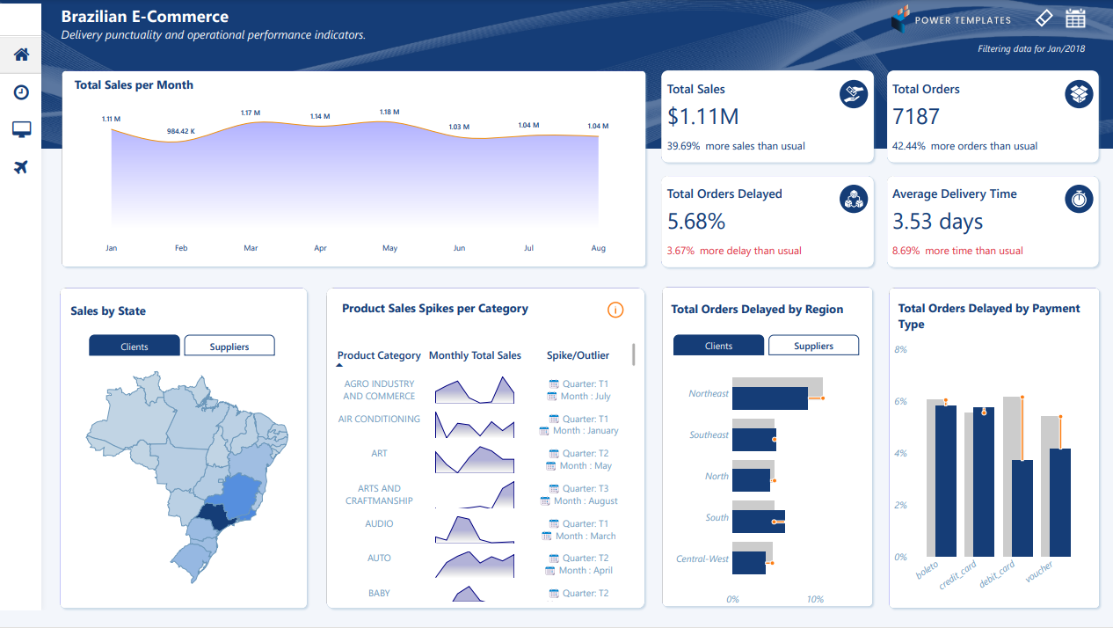
https://medium.com/%40edweenlim/data-build-tool-project-concepts-and-implementation-using-olist-brazilian-e-commerce-dataset-22fcf7d20c22
Notes:
https://medium.com/%40edweenlim/data-build-tool-project-concepts-and-implementation-using-olist-brazilian-e-commerce-dataset-22fcf7d20c22

Slide 2
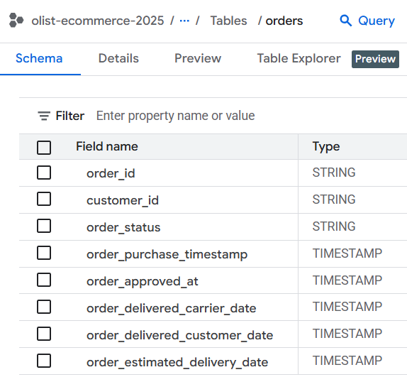
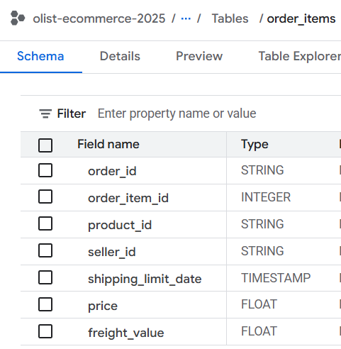
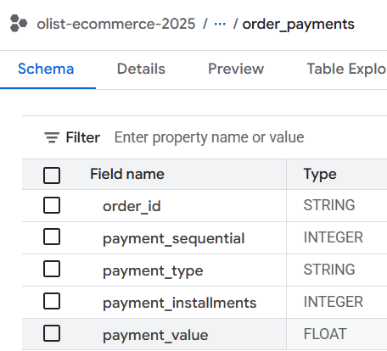
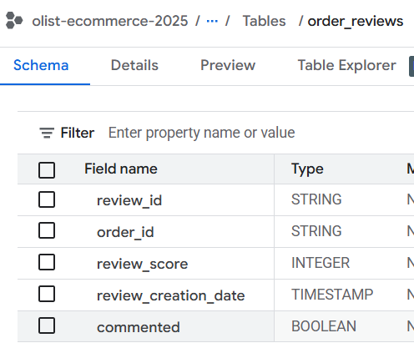
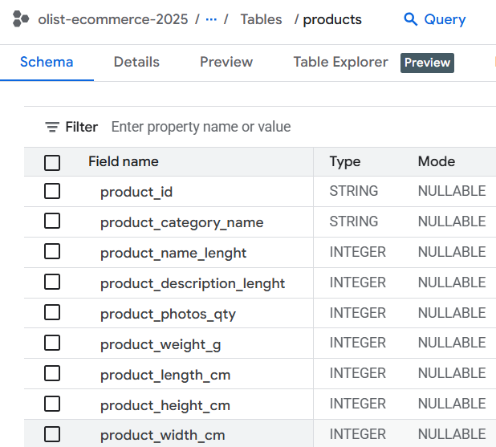
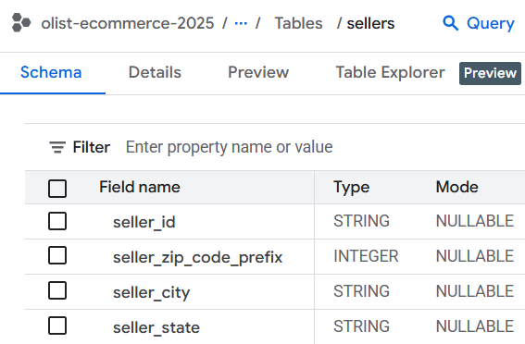
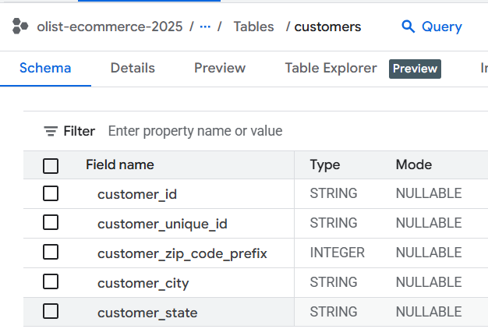
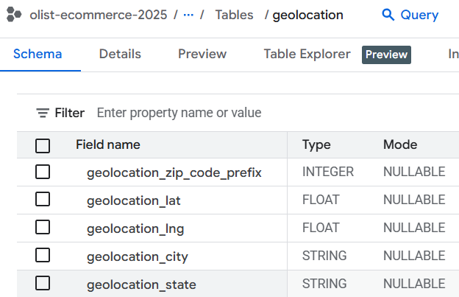
B
C
D
A
E
F
G
H

Slide 3
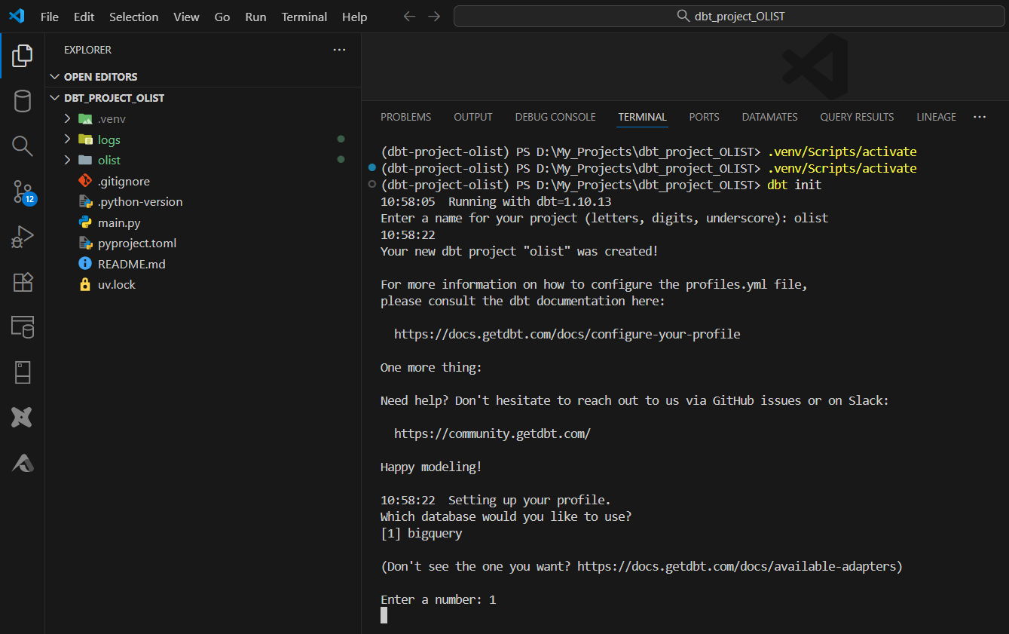

Slide 4



Slide 5
products
Order-items
Order-reviews
Orders
+
order-payments
Customers
Sellers

Slide 6
DBT CLOUD / CATALOG

Slide 7
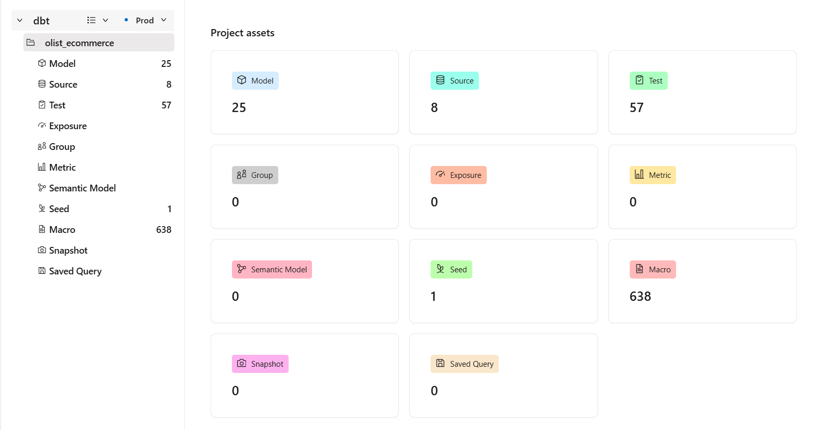
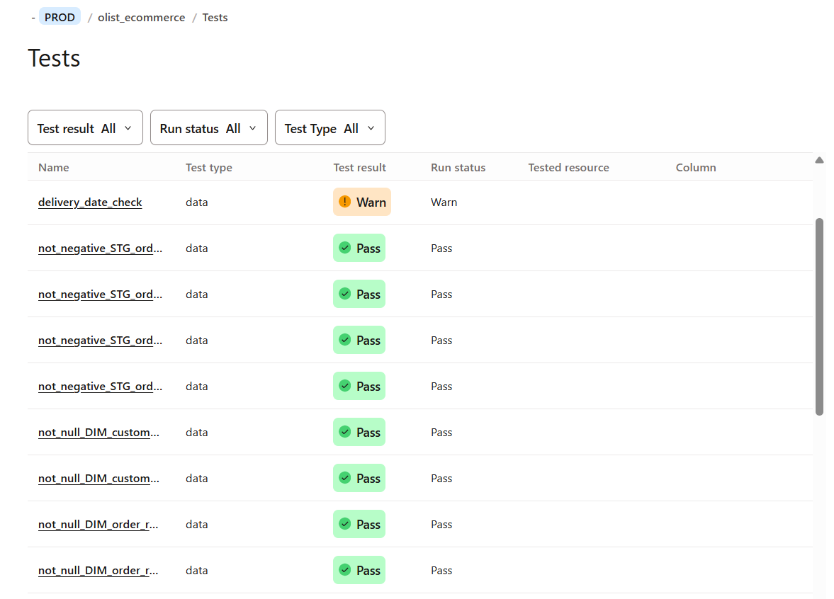

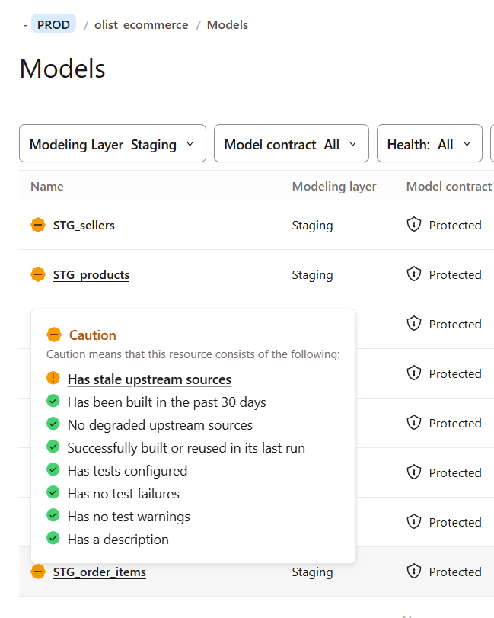

Slide 8
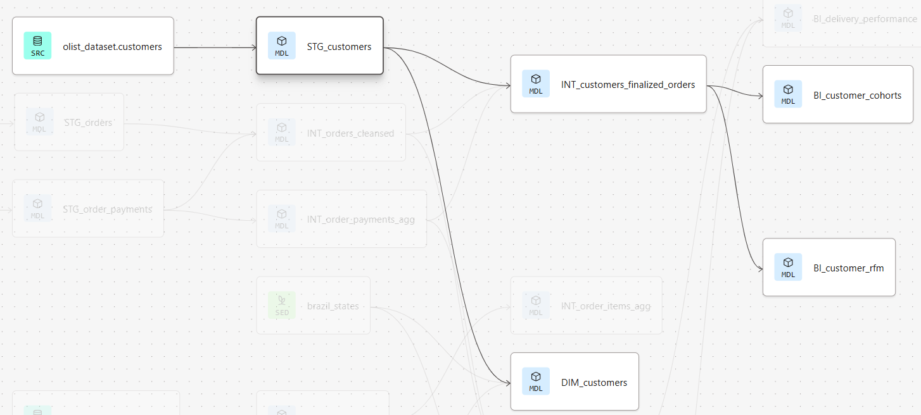
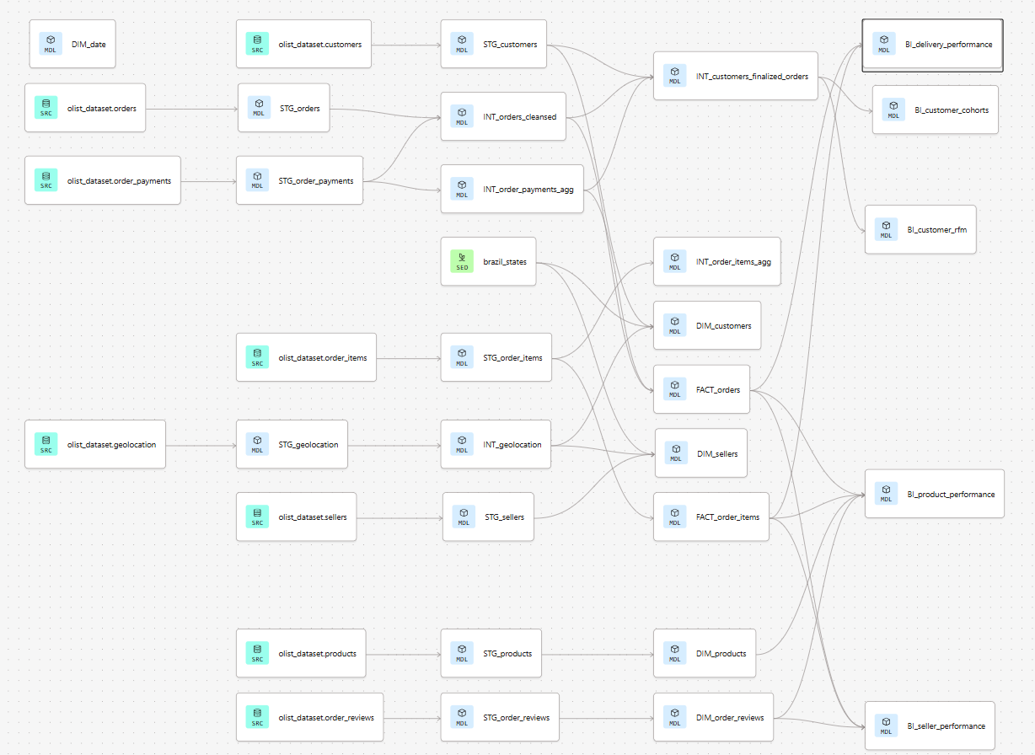
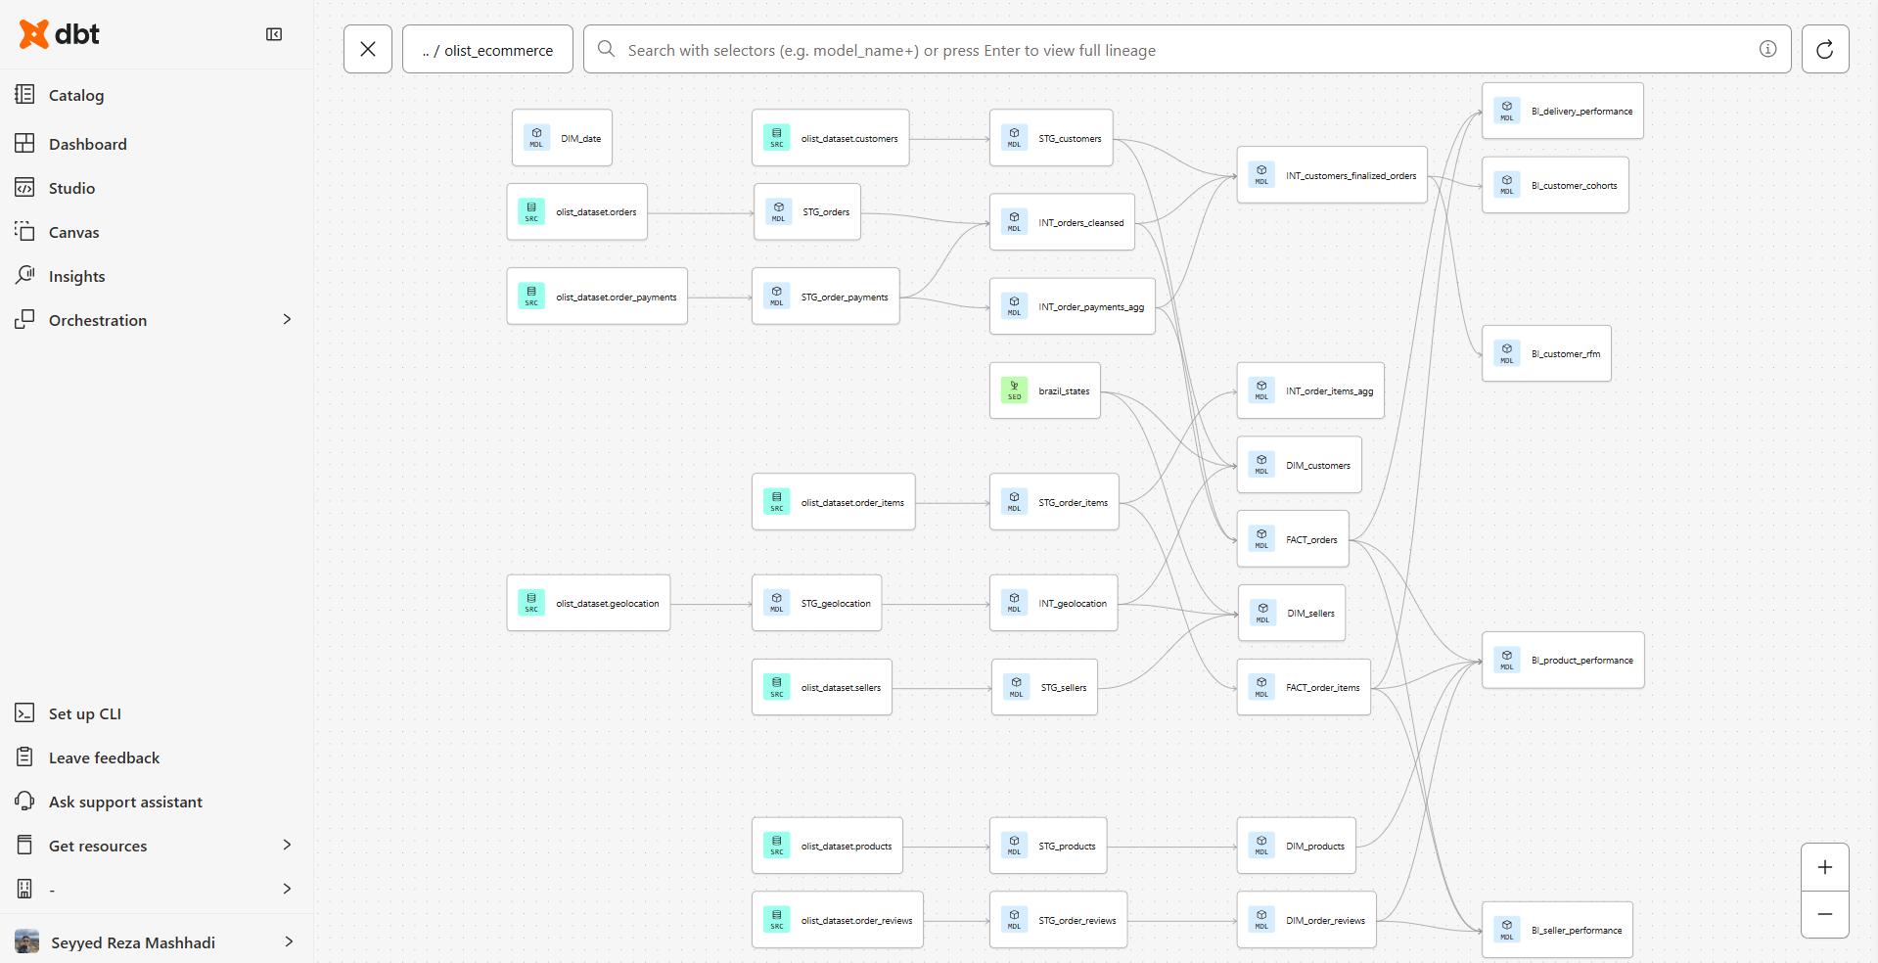

Slide 9
DBT CORE EXPORTS

Slide 10
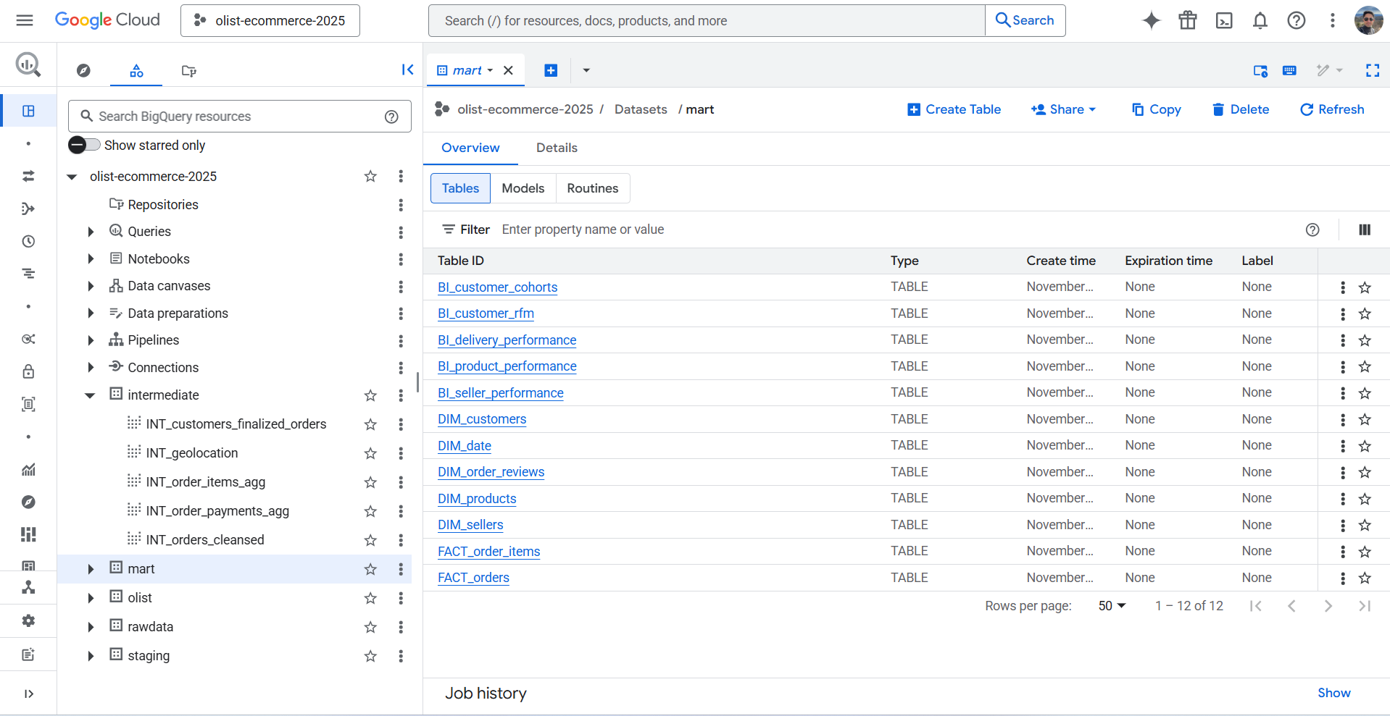

Slide 11
